Slide 1
OCR Model For Visually Impaired People Using Tensorflow
DOMAIN- MACHINE LEARNING
Team Member:
Apurva Waingankar
Anuja Velaskar
Nidhi Munavalli
Guided by: Prof.Ramya RB

Slide 2
INTRODUCTION
There are many cultural, governmental, commercial and educational organization that manage large number of manuscript textual information. Text line segmentation in such document remains an open document analyses problem.
In this project, the model takes English text scanned image as an input. This image is analyzed in order to identify each letter or digit. When a character is recognized it converts it into braille language as well as in English language. The output is in the form of well recognized and understandable document.

Slide 3
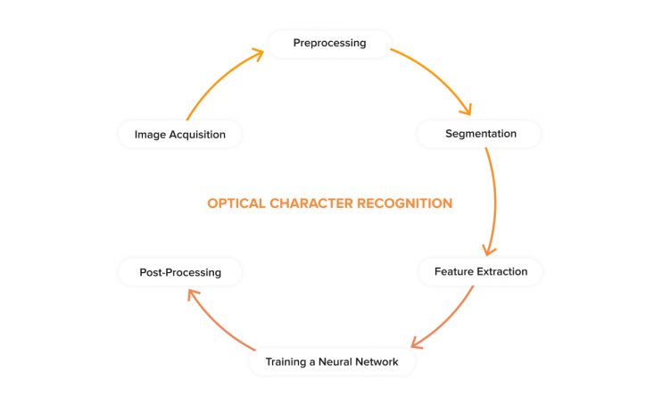
Steps in OCR Model

Slide 4
LITERATURE SURVEY
SN | PAPER TITLE | AUTHOR | SUMMARY
1 | Kannada text line extraction minimization and skew correction | 1.Sunanda dixit 2.Suresh Narayan 3.Mahesh bellur | 1.Segmentation of Textwritten Document. 2. Extraction of Textwritten documents. 3.This work also uses skew correction of the extracted text line.
2 | Line and Ligature Segmentation of Urdu Nastaleeq Text | 1.IBRAR AHMAD1, 2.XIAOJIE WANG1, RUIFAN LI1, MANZOOR AHMED2, AND RAHAT ULLAH3 | 1.The proposal mainly introduces two algorithms for line and ligature segmentation of Nastaleeq text images. 2. The proposed line segmentation algorithm places dots and diacritics more accurately as compared to Prevailing work relied more on zonal information and heuristics for line and ligature segmentation, respectively.

Slide 5
LITERATURE SURVEY
SN | PAPER TITLE | AUTHOR | SUMMARY
3. | Text line segmentation of hand written document of hindi and english | 1.Sunanda dixit 2.Sneha 3.Nilotpal utkalit 4.Suresh h n | 1.In this paper a method to detect and segment unconstrained hand written document written in English and hind where document image is first binarized and connected component are identified 2.Based on hough lines the text line are identified. 3.Skew angle is determined and than the skewness is minimized segmentation is then performed and the result is than refined by removing the noise which basically comprises component from adjacent line

Slide 6
Benefits for environment
Paperless revolution- The project saves the documents in softcopy and hence the paper work is reduced.
Environment friendly- Due to reduction in use of paper, deforestation is also reduced.
Reduced cost- Besides helping organization in cutting down the cost of hiring manpower for data extraction, OCR also helps in reducing cost like printing, copying, shipping charge, etc

Slide 7
Benefits for society
Retyping-It reduces the work of retyping the text as it can be directly scanned and converted to document.
Speedy digital searches -By converting scanned text into a word processing file, OCR lets you search through documents using keywords or phrases.
Typing new text-The image of a document to function like real text, where you can add new paragraphs, copy and paste, edit out an old reference.
Saving space -The documents can be converted to pdfs saving the space.
Time management-Manual data entry demands hours,efforts and sanity with time dedicated for for document creation and endless forms.
Accessibility-For the visual impaired people, OCR software can help turn books, magazines and other printed documents into accessible files that they can get printed into Braille language.

Slide 8
TECHNOLOGY STACK
Tensorflow-TensorFlow is a symbolic math library, and is also used for machine learning applications such as neural networks.It is used for training the model.
Open CV- Open source computer vision is a library of programming functions mainly aimed at real-time computer vision. In this project it is used for image processing.
Python 3.7- Python is an interpreted, high-level, general-purpose programming language.It is the programming language used in this project with its basic libraries.
Azure jupyter notebook- It is a web-based interactive computational environment for creating Jupyter notebook documents.
Dataset: Dataset would contain a Text Format letters and digit,from this dataset Recognition of document would be done.

Slide 9
Activity Diagram

Slide 10
User case Diagram

Slide 11
Applications-
The project recognises scanned image and converts it into english text document. The document would be precise and more accurate.
Assistive technology for blind and visually impaired users- The project converts the scanned image into braille language.This is helpful for visually impared people.They can easily understand and interpret it.

Slide 12
CONCLUSION
The objective of segmentation and recognize character in image have been achived.Hereby we will be successfully implementing optical character recognition model using Tensor flow.
This work presents a robust scheme of extracting text line from a scanned Text document image .

